Slide 1

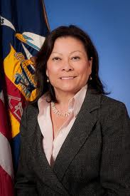

The Americans with Disabilities Act (ADA)
The 22nd Anniversary
The Will to Believe and Achieve
Disability Awareness Forum
For Veterans and Civilians
Town Hall Meeting
Monday, July 30, 2012
Jacob K. Javits Federal Building
Conference Center – 6th Floor
26 Federal Plaza
New York , NY 10278
2:00 PM – 4:00 PM
Access to Event Begins at 1:00PM
RSVP BY JULY 23, 2012
By Email: micioni.maria@dol.gov
By Phone: 212-264-7742
Please let us know any accommodations required
PATRICIA SHIU
Director, OFCCP

