Slide 1


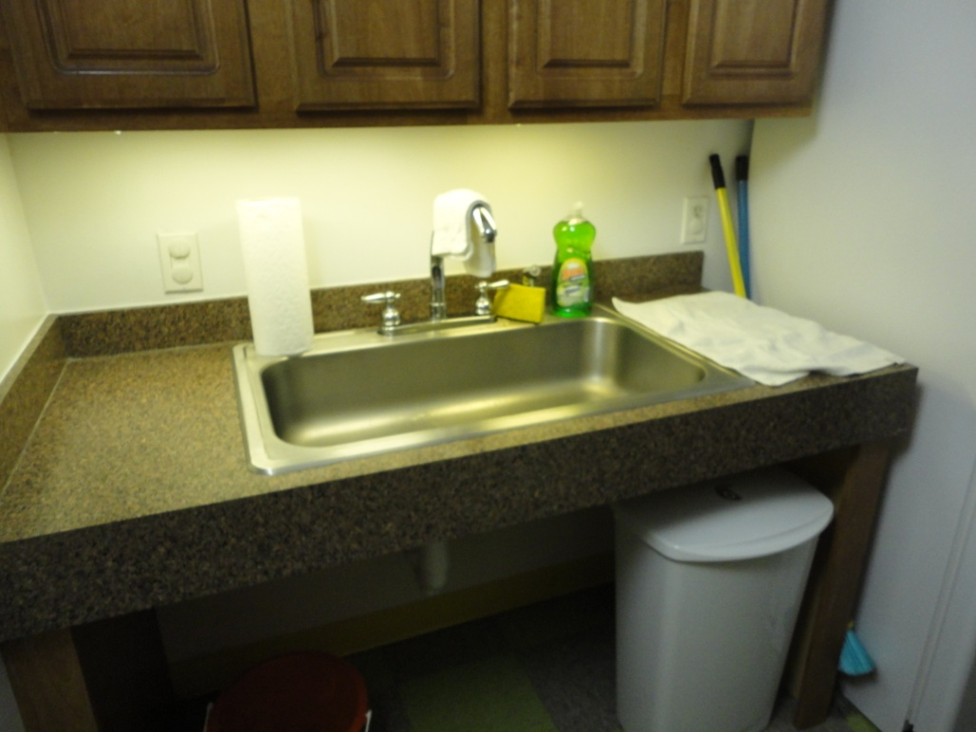
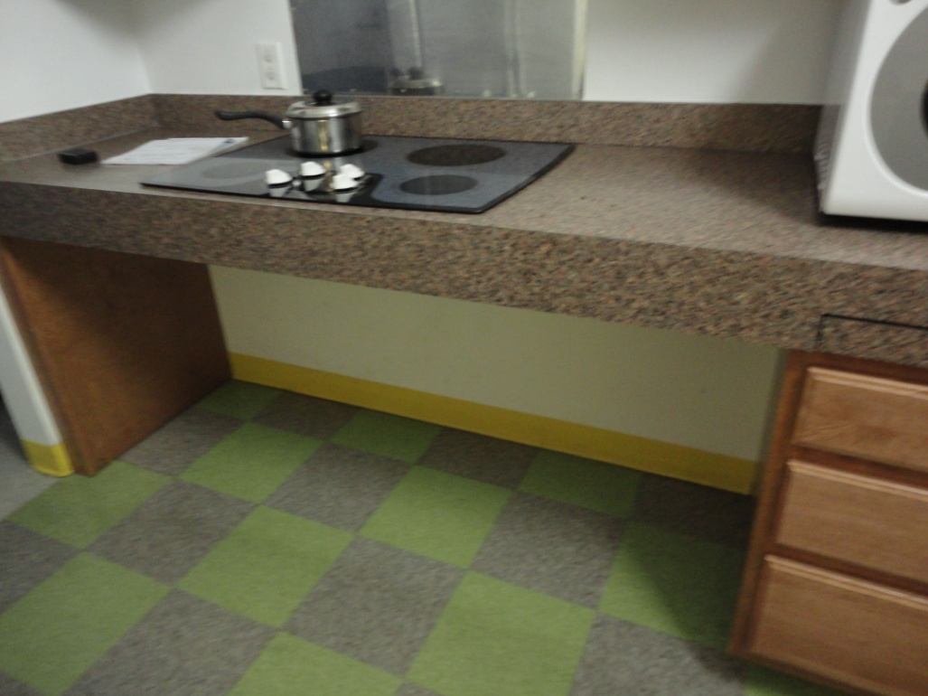
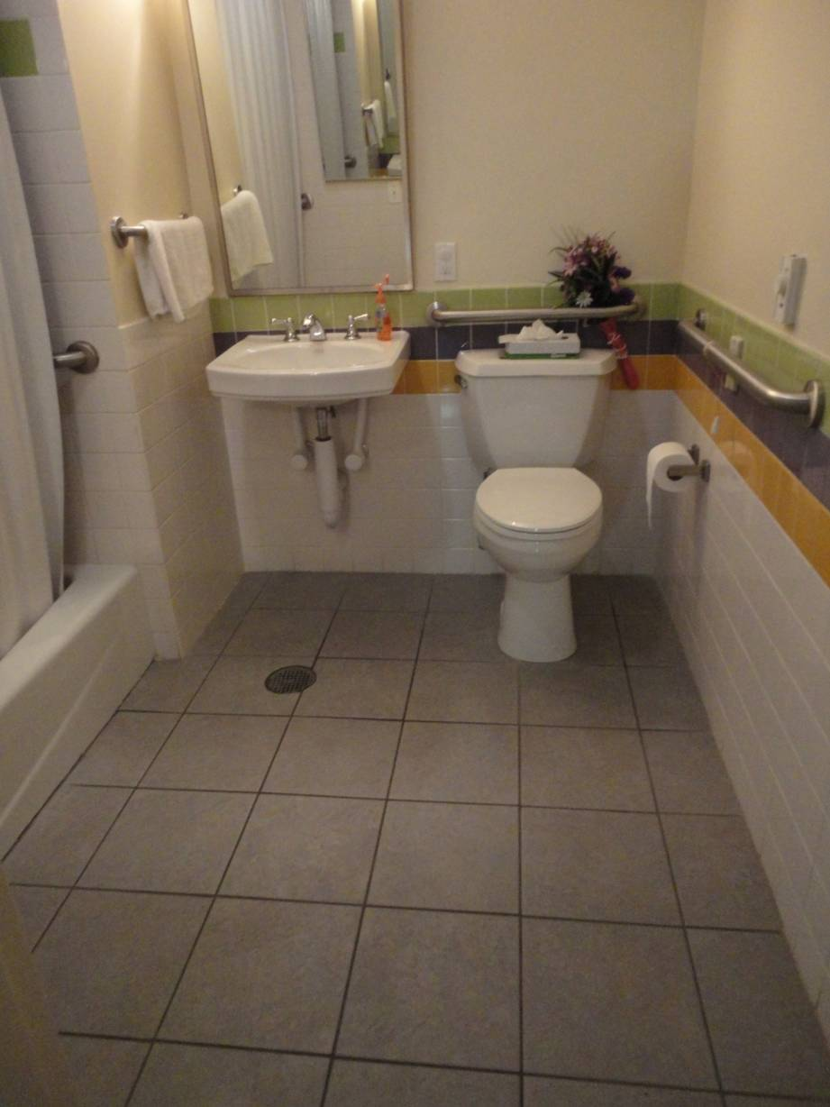
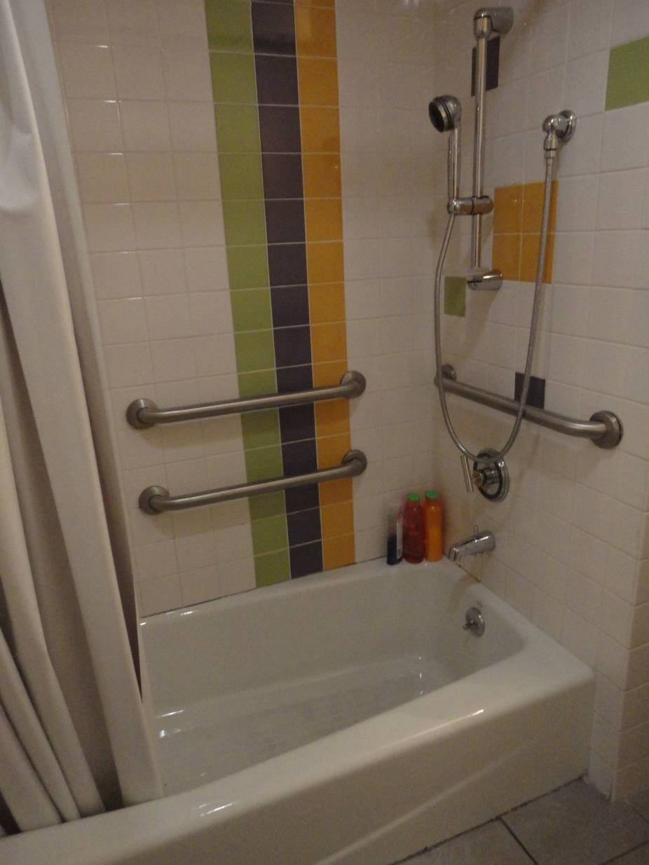
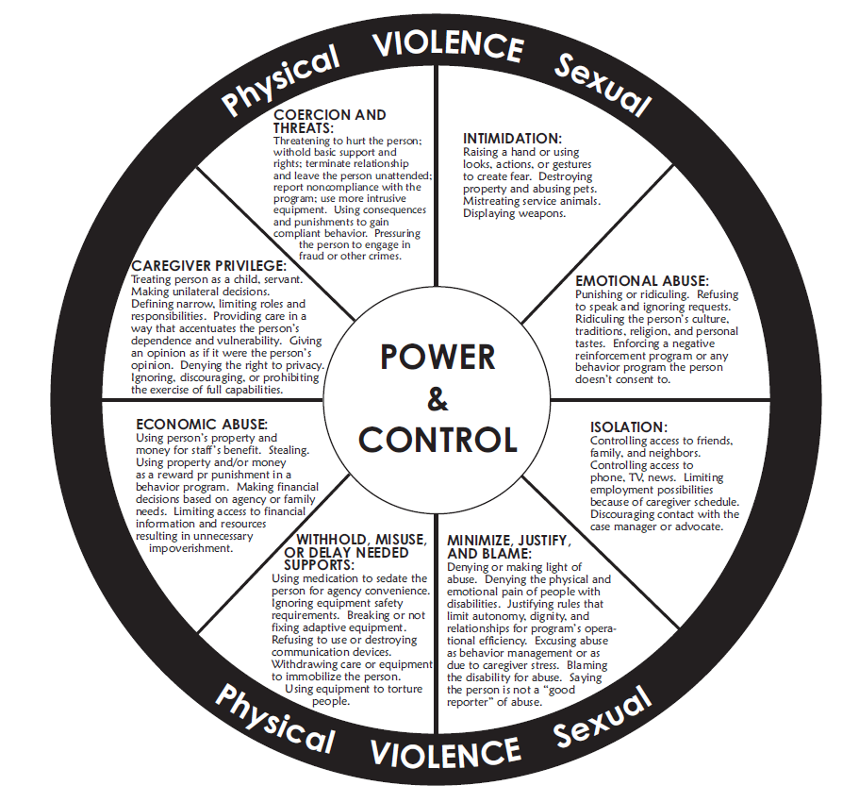
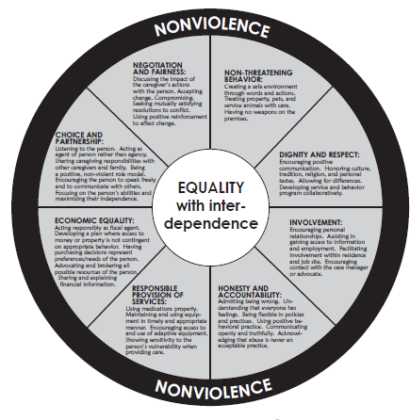
Occupational Therapy with Survivors of Domestic Violence:
An Initial Cross Case Analysis for Determining Factors of Success in a Shelter Setting
Christina Marino, MS, OTR/L and Patricia Motus, OTR/L
Occupational Therapy
and Domestic Violence
Cross Case Analysis
Freedom House
Domestic violence is societal problem that reaches past race, age, religious beliefs, ethnic background, and economic status; however, women are so profoundly affected that 1 in 4 women experience domestic violence in her lifetime (Thajden & Thames, 2000). The cost of domestic violence is staggering at 5.8 billion per year with $4.1 billion allocated for medical (physical and mental) health costs (NCADV, 2007). The cycle of violence causes survivors to face significant challenges engaging in meaningful occupations especially instrumental activities of daily living such as home management, parenting, money management (DeLany, Javaherian-Dysinger, & Underwood, 2011). In addition, survivors’ participation in work, education, rest /sleep, leisure and social participation can be significantly affected. Thus, occupational therapists are poised to provide skilled intervention related to life skills training to this population. According to recent literature, shelters who have employed occupational therapists to provide life skills training have found the programming to be effective in assisting individuals learn ways to live with increased independence (Gorde et al.; Gutman et al., 2004; Helfrich et. al, 2006; Helfrich & Aviles, 2001; Hefrich, Badiani, & Simpson, 2006; Helrich & Rivera, 2006). Most of the services highlighted in the literature are provided in the group setting only. At Freedom House, residents engage in individual OT sessions in addition to optional groups. Therefore, this appeared to be an avenue for further research. Many implications arise from this analysis including further research, advocacy, and exploring ways to integrate treatment approaches within the community setting to other occupational therapy settings within the medical model where many survivors of violence seek treatment.
A cross case analysis approach was chosen as a preliminary means to evaluate effectiveness of occupational therapy interventions with survivors of violence residing temporarily in a shelter setting. According to literature (Yin, 2003), a cross case analysis allows the researcher to see similarities and differences between cases chosen. In addition, it allows for initial research using retrospective data. Cases must be selected carefully according to criteria in order to predict results or to predict contracting results (Yin, 2003).
For this project, all cases of clients from May 2010-September 2010 who participated in occupational therapy were reviewed. During this span of time, the occupational therapy evaluated ___ clients. From this sample, we developed a criteria to select appropriate cases for the study. Clients who had attended 3 groups and 3 individual sessions including the initial evaluation and who met all occupational therapy goals were selected. In total, three cases met the criteria for selection: MB, LV, and VP. In the chart below is a chart highlighting demographic information about each of these women. The reason the above criteria were chosen reflect trends in the literature. Many of the studies presented in our literature review focus on OT intervention in the group setting only. Therefore, the writers aimed to evaluate and review successful clients who engaged in both group and individual intervention. Below, chart 1 is displaying demographic data of the clients.
What?: An accessible emergency shelter for survivors of domestic violence with disabilities and their families in New York, NY.
Who?: Serves residents with various types of disabilities - Physical, Emotional, Intellectual, Developmental, Visual, Hearing.
Supports for Residents :Safety, Social Workers, RN onsite, Psychiatry, Housing & Entitlements, Legal Advocacy and Referrals, Referrals to specialized treatment, Individual and Group counseling, Children’s Services, Childcare & Recreation, onsite Board of education liaison, an aftercare program called Beyond Freedom and Occupational Therapy through skill building.
.
 | Self-Efficacy Scale | Beck’s Depression Inventory | Number of Children | Years of Abuse | Ethnic Background | Socioeconomic Status | Legal Status | Individual Sessions Attended | Groups Attended | Goals
MB | 1.9/10 | 19/60 | 1 | 4 | Indian | Lower-middle class + $5,000 savings | Documented | 5 | 21 | Stress Management, Self-Esteem, Sleep
LV | 2.1/10 | 7/60 | 4 | 19 | Hispanic (Colombian) | Lower class + No savings | Undocumented | 3 | 3 | Coping Skills, Leisure Exploration, Computer skills
VP | 2.5/10 | 0/60 | 5 | ~ 2 | African American | Lower middle class + min. savings | Documented | 5 | 15 | Vocational Counseling, Pain Management
Domestic Violence Is About
Power and Control
Example of private, accessible apartment at Freedom House. Some units are equipped with walk- in showers. In addition, durable medical equipment is available for clients.
Occupational Therapy Services at
Freedom House
Domestic violence is based in a cycle of power and control. The wheels presented were developed for persons with disabilities affected by violence. The power and control wheel is characterized by a pattern of actions that an individual uses to intentionally control or dominate his intimate partner, which are located in the center. A batterer systematically uses threats, intimidation and coercion to instill fear in his partner. These behaviors are the spokes of the wheel. Physical and Sexual violence holds it all together---this violence is the rim of the wheel. This violence is often the type that is noticed. In contrast, the equality wheel is based on respect and helps survivors understand where to take future relationships.
In Chart Two, a breakdown of the groups and individual sessions that each client attended is presented. In parentheses at the end of each line is number of times the patient engaged in this group or session during their stay at Freedom House.
The three women in the case analysis each engaged in group and individual sessions. The occupational therapy program led by OTR with a roster of OT Level II students pr a number of services including:
  Skill-Building Groups
  Initial Evaluations of all residents
  Individual sessions based on initial evaluation results
 | MB | LV | VP
Individual Sessions | 1. Stress Management (2) 2. Vocational Counseling (2) 3. Parenting (1) | 1.Positive coping strategies (2) 2.Stress Management (1) | 1. Back pain/ HEP (1) 2. Vocational Counseling (3)
Groups | 1.Mommy and Me (6) 2. Cooking (5) 3. Yoga (9) 4. Drum Circle (2) | 1.Cooking (3) | 1.Drum Circle (9) 2.Cooking (6) 3. Mommy and Me (1)
Groups
Fitness
Resident Advisory Committee
Drum Circle
Freedom Spa
Mommy/Daddy and Me
Vocational Group
Yoga
Individualized Services
Money Management & Budgeting
Self Care
Stress Management
Prevocational and Vocational Counseling
Development of Parenting Skills
Environmental Adaptations
Nutrition and Health Information
Development of Coping Skills
Development of Healthy Leisure Activities
Home Management
Time Management
Pain Management
Illness Management
Improvement of Self Esteem
In Chart 3, the cross case analysis is displayed using a 0-2 scale. A scale of 0-2 was utilized in chart to perform the retrospective cross case analysis with zero representing least desirable qualifier and two representing the most desirable
OT Evaluation Process
 | Self-Efficacy Scale | Beck’s Depression Inventory | Number of Children | Years of Abuse | Ethnic Background | Socioeconomic Status | Legal Status | Individual Sessions Attended | Groups Attended | Goals Met | Totals
MB | 0 | 0 | 2 | 1 | - | 2 | 1 | 1 | 2 | 0 | 6
LV | 2 | 1 | 1 | 0 | - | 0 | 0 | 0 | 0 | 2 | 6
VP | 1 | 2 | 0 | 2 | - | 1 | 1 | 1 | 1 | 1 | 10
Occupational therapy is one of the many services provided to residents of Freedom House and work closely with the interdisciplinary team. Occupational therapy students routinely perform evaluations with residents under the supervision of the OTR/L. Each evaluation includes:
Emerging Themes and Conclusion
Components of Occupational Therapy Evaluation
Background Information including PMH and history of abuse
ROM and MMT
Sensation
Functional Status- ADL and mobility
Cognitive Assessment (MOCA)
Beck’s Depression Scale
Self Efficacy Scale
Purpose of OT Evaluation
Help survivors take control of their lives
Empowering
Life skills building
Find a purpose
Achieve personal satisfaction and role competence
Develop healthy independent lifestyles
Improving quality of life
Learning to be more assertive
Facilitating effective decision-making skills
Utilizing adaptive coping skills
The same qualifiers used in the demographic data were used in the analysis as these were deemed most important by the writers. The client with the highest score was deemed most successful. This client, VP, was in the abusive relationship for less time compared to the other individuals. She had the lowest score on the Beck’s Depression Inventory. The other two clients, MB and LV, each had the same score of six. Interestingly enough, MB had the most savings and the attended the greatest number of groups but scored the highest on becks Depression Inventory indicating possible borderline clinical depression. LV attended least number of sessions and faced challenges of minimal finances and undocumented legal status.
It is important to remember that all three women were deemed most successful within the Freedom House Occupational therapy program from May –September of 2010. These three women may have been successful occupational therapy clients because they demonstrated readiness for change. Most women require 5-7 attempts before successfully ending an abusive relationship ( ..). It seems that in the cases of these three women, they entered shelter and were ready to embrace a new lifestyle. A further trigger for change for the three women was the involvement of their children in the abusive environment. The three ladies mentioned in this case analysis left their abusers when children became involved in the abuse.
Through this analysis process, a number of themes emerged.
Socioeconomic status and education level were not as much of predisposition to DV as anticipated by the writers. For exampled, MB had savings in addition to a Bachelor’s degree in Education.
One of the three women scored at the level of borderline clinical depression on the Beck’s Depression Inventory as one of the most successful clients in the occupational therapy program during the three month window of May-September 2010.
The number of children, race/ethnicity, and age were not a factor of success amongst the three cases.
Mothers were advoctes for their children leaving the abusive relationship once children became involved in the abuse.
Finally, many implications arise from this analysis including further research, advocacy, and exploring ways to integrate treatment approaches to other occupational therapy settings. While there are a number of limitations to this analysis such as the use of retrospective data and small number of cases, it may help us begin to understand why certain clients are successful and how to further OT programs working with survivors of violence
“Evaluation is focused on determining what the survivors want and need to do and identifying the factors that act as supports or barriers to performance of the desired occupations” (AOTA, 2008).

